Slide 1




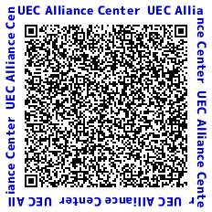
Map from Chofu Station to UEC Alliance Center
UEC
WEST Campus
UEC
EAST Campus
McDonald’s
7-Eleven
🚥
🚥
🚥
Shimoishiwara
Kojimacho
National Route 20
Dentsudai-dori
Chofu Sta.
UEC
Alliance Center
OK Store
Sport Club
MEGALOS Chofu
SEIYU
RISONA
Bank
PARCO
Family
Mart
To Hachioji
Chofu Station
To Shinjuku
TRIE
AEON Cinema THEATUS Chofu
Central
Exit
Google Maps QR code
with the UEC Alliance Center set as the destination
Police
Box
Aflac
Chofu City
Green Hall
Chofu Kichinto
(Conference
Dinner Venue)
LAWSON
MUFG
Bank
DOUTOR

Slide 2
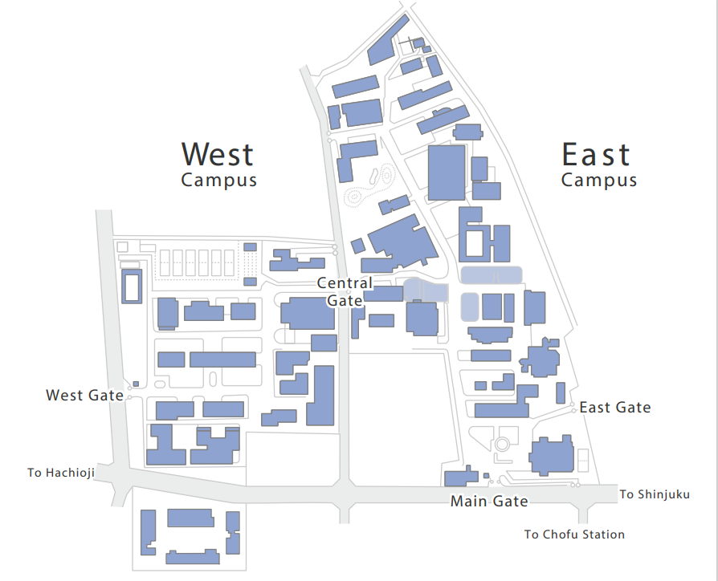
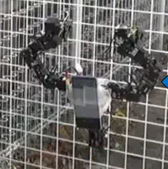

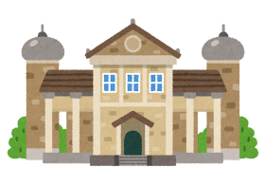









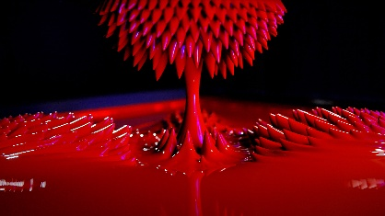
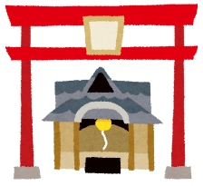
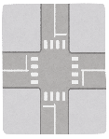
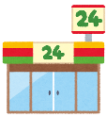
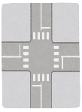
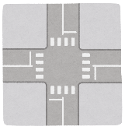
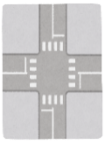
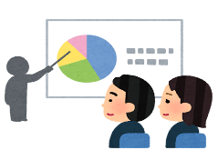
Map around UEC
KIMURA Kohei Lab
Room 501, 5th floor
East 2 Building
UEC Museum of Communications
Visit on the afternoon of July 30
University Center
Lunch Place
and
Opening Reception Venue on July 28
(Restaurant Harmonia on the 3rd floor)
TAKAHASHI Hiroki Lab
Room 501, 5th floor West 6 Building
KODAMA Sachiko Lab
Room 105, 1st floor
Room 402, 4th floor
West 6 Building
Fuda Tenjin-sha
Visit on the afternoon of July 28
Sachiko Kodama 《Gravity Garden》
Short Video
You can also enter the West Campus from here.
7-Eleven
(convenience store)
UEC Alliance Center
ACIVS Venue

