Slide 1
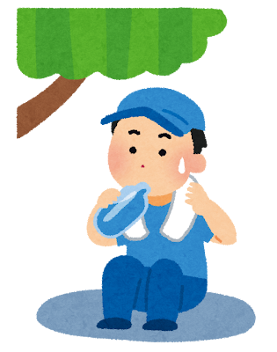
Let’s have fun in Tokyo!
But, please be careful of heatstroke and stay hydrated.

Slide 2
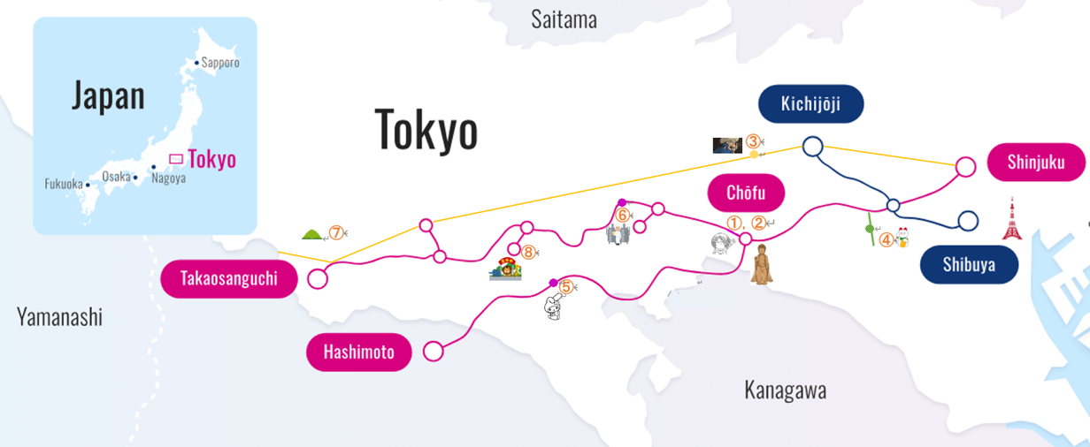

Slide 3
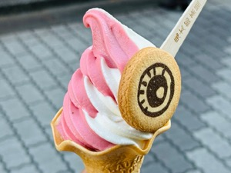
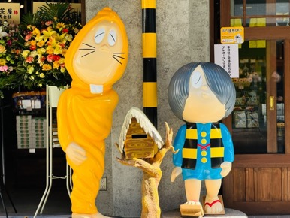
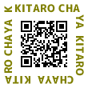
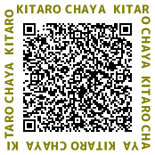
① KITARO CHAYA
As you explore, you'll discover a unique connection to Japanese folklore, especially with "yokai" (supernatural beings). This is largely due to Shigeru Mizuki, the creator of "GeGeGe no Kitaro," who was a long-time resident of Chofu. Take a stroll down Tenjin-dori, a street adorned with whimsical yokai statues. It's a fun and quirky introduction to these fantastical creatures! At the end of your walk, be sure to visit Kitaro Chaya, a charming cafe where you can enjoy themed treats and immerse yourself further in the world of Kitaro.
10:00am-5:00pm
KITARO CHAYA HP
Tripadvisor
From Chofu Station (KO18), a 5-minute walk. It is located along the Tenjin-dori Street.

Slide 4
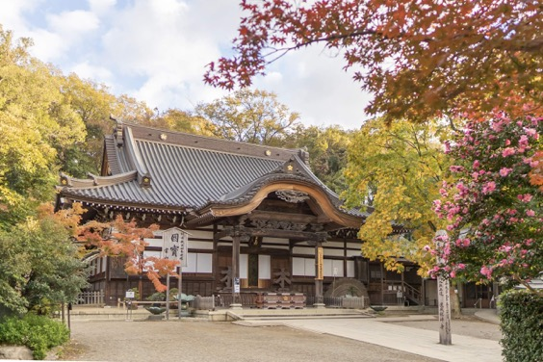
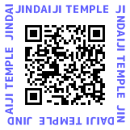
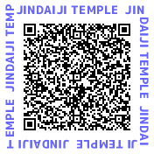
② JINDAIJI
Jindaiji Temple, a beautiful and historic Buddhist temple established over 1,300 years ago, nestled in the green hills of Chofu. It's one of Tokyo's oldest temples, renowned for its tranquil atmosphere and rich cultural heritage. Among its treasures is a National Treasure, the Hakuho-era bronze statue of Shakyamuni Buddha, a rare and exquisite example of early Buddhist art in Japan, housed in the Main Hall. Jindai-ji is also famously associated with Kakudaishi, a fierce guardian deity depicted with horns, believed to ward off evil and misfortune, making it a popular spot for those seeking protection. The temple grounds are also famous for their delicious soba noodles and lush botanical gardens.
5:00am-6:00pm
JINDAIJI HP
Tripadvisor
Take a taxi ride from Chofu Station(KO18), to Jindai-ji Temple usually takes about 15to20 minutes, depending on traffic. The fare will be approximately 1,500 to 2,000 yen. Just tell the driver "Jindai-ji" (神代寺)

Slide 5
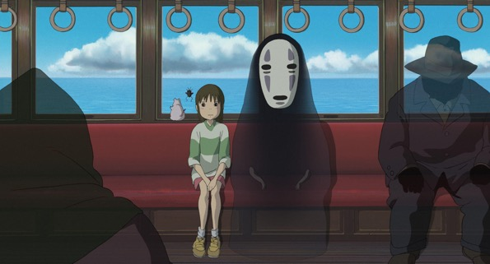
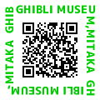
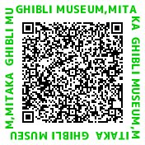
③ GHIBLI MUSEUM, MITAKA
The Ghibli Museum, Mitaka, offers a magical journey into the beloved world of Studio Ghibli films. Visitors can explore original artworks, watch exclusive short films, and wander through enchanting exhibits. It's a must-visit for families and animation enthusiasts, offering an unforgettable experience. Tickets must be purchased in advance.
\1,000 / 10:00am-6:00pm
Reservation required
From Chofu Station(KO18), take the Keio Line (Limited Express or Semi-Limited Express) directly to Shinjuku Station(KO01) (approx. 15 minutes). At Shinjuku, transfer to the JR Chuo Line and take it to Mitaka Station (JC12) （approx. 15to20 minutes). From Mitaka Station, the museum is about a 15-minute walk through a pleasant park area.
Ghibli HP
Tripadvisor

Slide 6
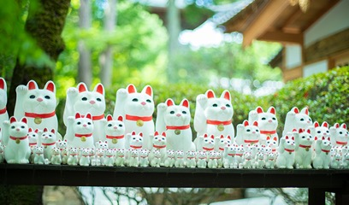
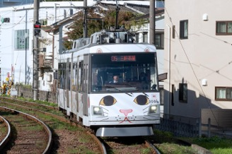

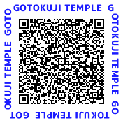
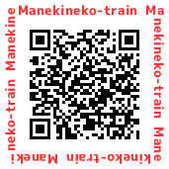
④ GOTOKUJI
Gotokuji Temple in Tokyo is famous as the origin of the "Maneki-neko," or beckoning cat, believed to bring good fortune. Visitors will see countless Maneki-neko statues here, creating a charming and unique sight. It's a peaceful cultural spot, ideal for a short, delightful visit, especially for cat lovers.
Visiting Hours: 6:00am-5:00pm
Office (Charms Shop): 8:00am-3:00pm
From Chofu Station(KO18), take the Keio Line (bound for Shinjuku, Local train) to Shimotakaido Station(KO07). At Shimotakaido Station, transfer to the Tokyu Setagaya Line (SG10). 5-minutes walk from Miyanosaka Station(SG07), or 15-minutes walk through the shopping street from Yamashita Station(SG08).
GOTOKUJI HP
Tripadvisor
Schedule of
Manekineko-train
Note: One of the Setagaya Line trains is a Manekineko wrapped train. Please check the website for its operating schedule.

Slide 7
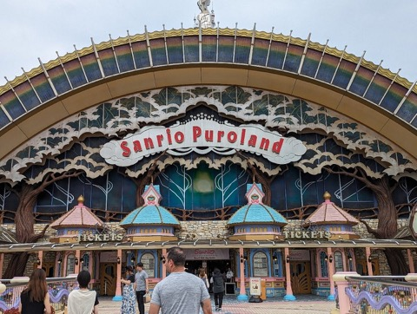
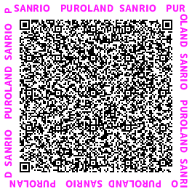

⑤ Sanrio Puroland
Sanrio Puroland is an enchanting indoor theme park dedicated to popular Sanrio characters like Hello Kitty, My Melody, and Little Twin Stars. It offers a whimsical experience with delightful shows, parades, and attractions that appeal to both children and adults. You can meet your favorite characters, enjoy various rides, and browse exclusive merchandise in a vibrant, kawaii atmosphere, making it a perfect family outing.
\5,300 / 8:30am-6:00pm
Reservations are recommended
From Chofu Station(KO18), take the Keio Line directly to Keio-Tama Center Station(KO41). The journey typically takes around 15to20 minutes by express or semi-express train. Sanrio Puroland is just a 5to7-minute walk from Keio-Tama Center Station.
Tripadvisor
PUROLAND HP

Slide 8

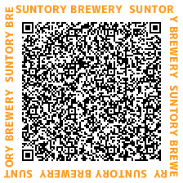

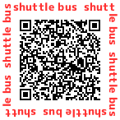
⑥ Suntory Brewery Musashino Factory
Discover the world of Japanese beer at Suntory Musashino Brewery in Fuchu, Tokyo. This facility offers engaging tours where you can learn about Suntory beer's brewing process, from selecting ingredients to fermentation. The highlight for many is the tasting session at the end, allowing you to sample fresh beer straight from the brewery. It's a fantastic opportunity to enjoy a unique, educational, and delicious experience.
\1,000-15,000 / 9:30am-5:00pm
Reservation required
From Chofu Station(KO18), take the Keio Line (Limited Express or Semi-Limited Express) to Bubaigawara Station(KO25).
Free shuttle service to the Suntory brewery is available from the rotary at Bubaigawara Station's North Exit.
Suntory Booking Site
Tripadvisor
Shuttle bus

Slide 9
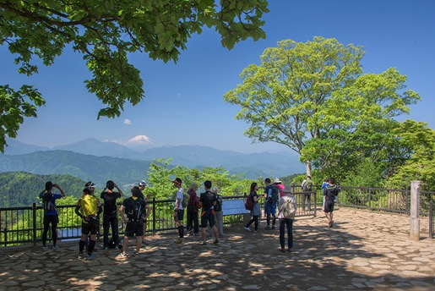
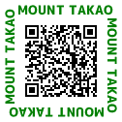
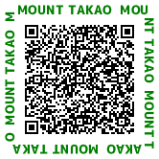
⑦ Mt. Takao
Mount Takao, a beloved natural escape near Tokyo, boasts a prestigious three-star rating from the Michelin Green Guide Japan. It offers an invigorating outdoor experience, with a variety of hiking trails suitable for all levels, leading to stunning panoramic views, including Mount Fuji on clear days. For those preferring an easier ascent, both a convenient cable car and a scenic ropeway transport visitors almost to the summit. Rich in nature and home to Yakuoin Temple, it’s a perfect short trip for families to enjoy Japan's beautiful outdoors.
From Chofu Station(KO18), take the Keio Line (Limited Express or Semi-Limited Express) directly to Takaosanguchi Station(KO53) . The journey is straightforward and typically takes about 25to30 minutes, making it a very accessible short trip. The cable car and ropeway stations are just a short walk from Takaosanguchi Station.
Takao tozan railway HP
Tripadvisor

Slide 10
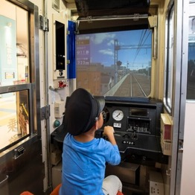
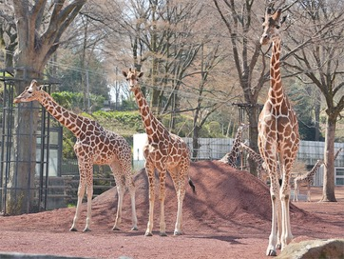
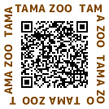



⑧ Tama Zoological Park / Keio Rail-Land
Tama Zoological Park is a unique zoo that embraces a vast, naturalistic environment where animals roam in large, open enclosures. It's famous for its focus on animal welfare and conservation, offering visitors a chance to see diverse species in settings that mimic their natural habitats.
\600 / 9:30am-5:00pm
Keio Rail-Land is a fun and educational railway park, operated by the Keio Corporation. It's a great spot for train enthusiasts of all ages, offering real train exhibits, simulators, and a diorama showcasing the Keio Line.
\400 / 9:30am-5:30pm
Tama Zoo HP
Tripadvisor
Keio Rail-Land HP
Tripadvisor
From Chofu Station (KO18), take the Keio Line Tama-Dobutsukoen Station(KO47). The zoo entrance is just a short walk from the station. The total travel time is approx 20to25 minutes.

